Slide 1
Two-Photon Microscopy
Anurag Abhijit Pendse
200260008
BB655 Course Seminar

Slide 2
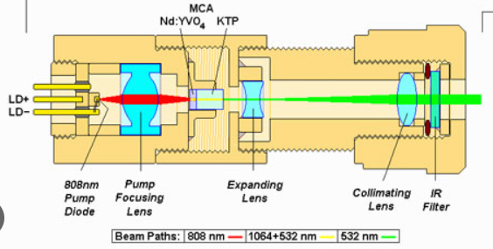
Non-linear optics
All of the optics we have seen in this course has been based on the linear response of materials to incoming radiation (Scattering and absorption were investigated in the linear regime).
Material properties allow us to go beyond the dominant linear optics regime and explore non-linear its responses to incoming radiation.
These properties can be used (spoiler alert: they are more widely used than you think) to our advantage to circumvent issues arising due to linear optics.
https://en-academic.com/dic.nsf/enwiki/418097

Slide 3
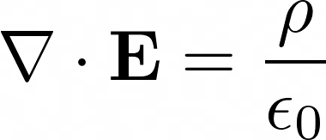

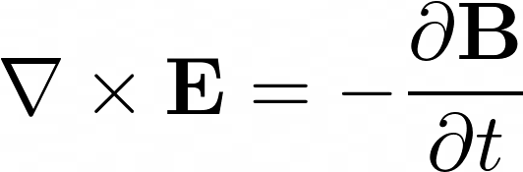
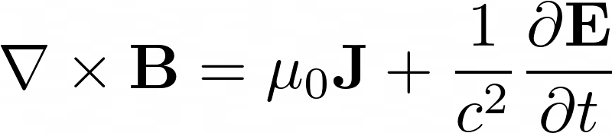

Recap of Linear Optics
Maxwell’s equations hold in all media.
While the equations themselves are linear, materials are not.
The response of materials to fields is captured in the Polarization P and the Magnetization M.
Polarization is what we care about, as it is the dominant effect in most material responses (especially in the biological context).

Slide 4
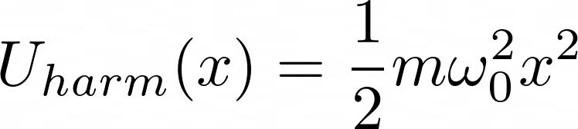
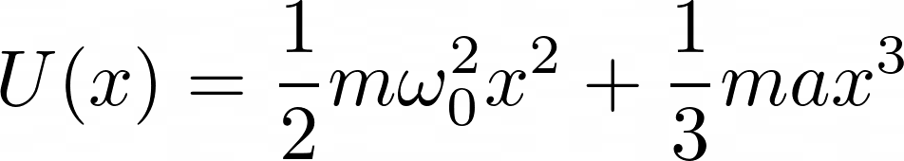
Non-linear material responses
All material responses are due to oscillations of the constituent atoms.
We model it as a driven spring-mass system
The electric field drives the system
The spring is harmonic in the linear regime
However, we can attempt to model real materials by adding anharmonicity
E

Slide 5
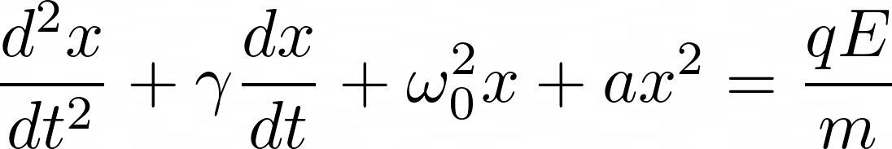
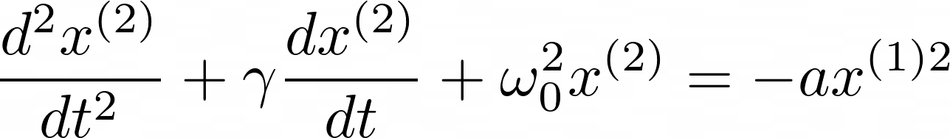
Non-linear material responses
The equation of motion we get is
We can solve this perturbatively, and the equation for the second-order perturbation (Assuming the Electric field is a first-order perturbation) will be

Slide 6
Non-linear material responses
If the electric field is a mixture of 2 frequencies, we have
We get
Thus, the square of the first-order perturbation (and thus, the second order perturbation) will involve terms of frequency

Slide 7
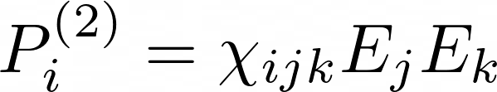
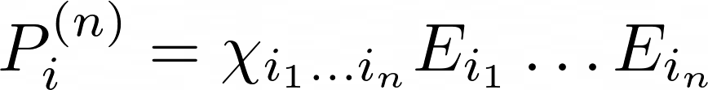
Non-linear material responses
We can write a second-order susceptibility as
We can continue perturbatively to get
Note that successive orders of polarization get weaker and weaker as the corresponding susceptibilities get smaller and smaller (Multiphoton processes are rare)

Slide 8
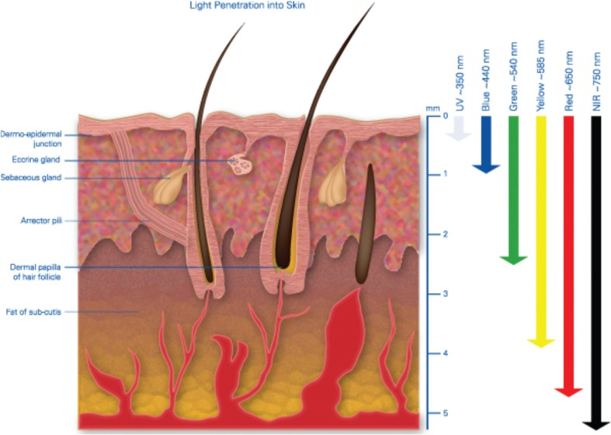
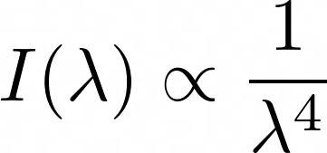
Biological Applications
Scattering is wavelength dependent
In tissues, lower wavelengths are scattered less as compared to shorter wavelengths
https://www.ncbi.nlm.nih.gov/pmc/articles/PMC5653719/

Slide 9
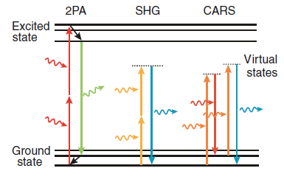
Biological Applications
Multiple possibilities exist for multi-photon processes, namely 2 Photon Absorption(2PA), Second Harmonic Generation(SHG) ,and Coherent Anti-stokes Raman Spectroscopy(CARS)
https://doi.org/10.1038/nmeth818

Slide 10
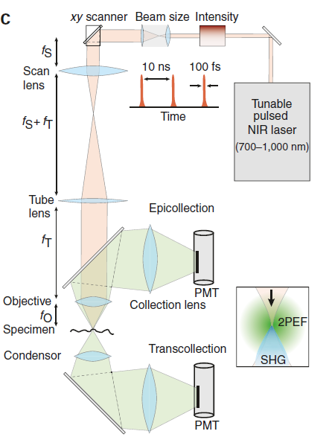
Biological Applications
The two photon excited fluorescence emission is isotropic and is seen in the epi and trans collection modes
The 2HG and CARS emissions are seen only in the trans-collection mode
https://doi.org/10.1038/nmeth818

Slide 11

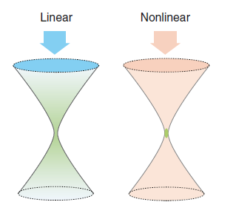
Advantages of non-linear optics
We have the signal strength due to non-linear effects to be super-linear with intensity (For an n photon process)
Thus, the entire signal is generated in the focal region
https://doi.org/10.1038/nmeth818

Slide 12
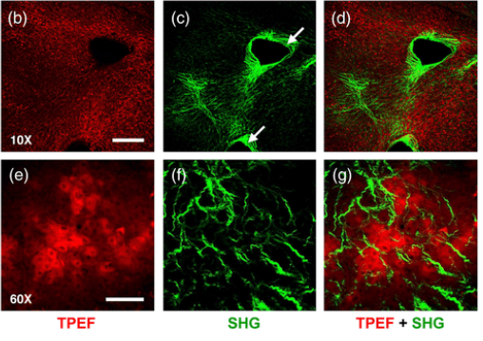
Advantages of non-linear optics
SHG emissions preserve phase and generate speckles, which can be imaged and analysed separately.
SHG can be used to image ordered structures in tissues
https://www.researchgate.net/figure/Two-photon-excitation-fluorescence-TPEF-and-second-harmonic-generation-SHG-in-human_fig2_265474661
Notes:
Image from human fibrotic tissue

Slide 13
Questions?

Slide 14
Thank You

